Slide 1
CSP554 Big Data Technologies
Module 06
Spark Core

Slide 2
Apache Spark
Apache Spark is an open source, Hadoop-compatible, fast and general purpose cluster-computing platform
It was created at AMPLabs in UC Berkeley as part of Berkeley Data Analytics Stack
Includes SPARK SQL, SPARK Streaming, MLlib (Machine Learning) and GraphX (graph processing)
Spark capable to run programs up to 100x faster than Hadoop MapReduce in memory, or 10x faster on disk
Spark can run on a Hadoop YARN cluster manager, and can read any existing Hadoop data
Spark itself is written in the language Scala, and runs on the Java Virtual Machine (JVM)

Slide 3
Apache Spark Architecture Landscape
Command
line
interfaces
Fast engine
for Interactive
SQL queries
Real-time
streaming
data analysis
Machine
learning
algorithms
Graph
processing
algorithms
pyspark
(Python)
Spark SQL
Spark
streaming
MlLib
GraphX
Spark Core Engine
spark-shell
(Scala)
YARN
HDFS

Slide 4
Apache Spark On the speed side…
Spark extends the MapReduce model to support more types of computations…
Including interactive queries and stream processing
Speed is important in processing large datasets…
It means the difference between exploring data interactively and waiting minutes or hours
One of the main features Spark offers for speed is the ability to run computations in memory
But the system is also more efficient than MapReduce for complex applications running on disk
Spark is capable to run programs up to 100x faster then Hadoop MapReduce in memory or 10x faster on disk

Slide 5
Apache Spark On the general purpose side…
Spark is designed to cover a wide range of workloads that previously needed separate distributed systems…
Including batch applications, iterative algorithms, interactive queries, and streaming
By supporting these workloads in the same engine, Spark makes it easy to combine different processing types... Which is often necessary in big data analysis pipelines

Slide 6
Apache Spark Components Spark Core
Spark Core contains the basic functionality of Spark
Including components for task scheduling, memory management, fault recovery, interacting with storage systems, and more
Spark Core is also home to the API that defines resilient distributed datasets (RDDs)
RDDs are Spark’s main programming abstraction
RDDs represent a collection of items distributed across many compute nodes that can be manipulated in parallel
Spark Core provides Java, Scala, R and Python APIs for ease of development, and for building and manipulating these collections

Slide 7
Apache Spark Components Spark Streaming
Spark Streaming is a Spark component that enables processing of live streams of data…
In the form of micro-batches of logs, messages or events
Spark Streaming provides an API for manipulating data streams that closely matches the Spark Core’s RDD API
Underneath its API, Spark Streaming was designed to provide the same degree of fault tolerance, throughput, and scalability as Spark Core

Slide 8
Apache Spark Components Spark SQL
Spark SQL is Spark’s package for working with structured data
It allows querying data via SQL as well as the Hive Query Language (HQL)
It supports many sources of data, including Hive tables and JSON
Beyond providing a SQL interface to Spark, Spark SQL allows developers to mix SQL queries with use of data manipulations supported by RDDs
Allows combining SQL with complex analytics

Slide 9
Apache Spark Components MlLib
Spark comes with a library containing common machine learning (ML) functionality, called MlLib
MlLlib provides multiple types of machine learning algorithms…
Including classification, regression, clustering, and collaborative filtering…
As well as supporting functionality such as model evaluation and data import
It also provides some lower-level ML primitives, including a generic gradient descent optimization algorithm
All of these methods are designed to scale across a cluster

Slide 10
Apache Spark Components GraphX
GraphX is a library for manipulating graphs and also performing graph-parallel computations
Like Spark Streaming and Spark SQL, GraphX extends the Spark RDD API
Allows us to create a directed graph with arbitrary properties attached to each vertex and edge
GraphX also provides various operators for manipulating graphs (e.g., subgraph and mapVertices) and a library of common graph algorithms (e.g., PageRank and triangle counting)

Slide 11
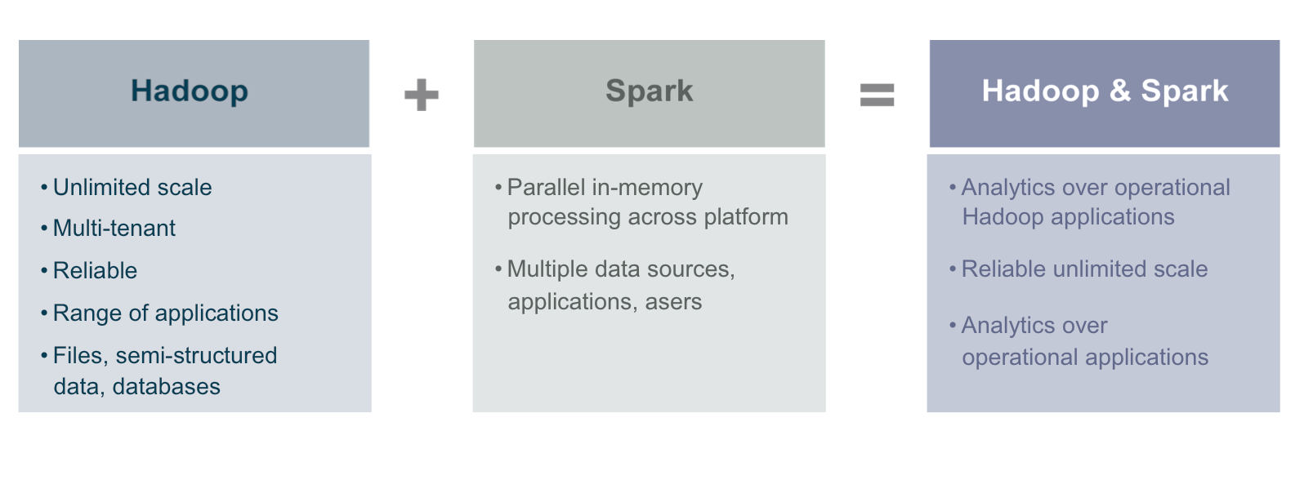
Hadoop and Spark
Spark can execute in standalone mode or using a cluster manager other than YARN (MESOS)
But using SPARK on a Hadoop cluster with YARMS as its cluster manager offers numerous benefits

Slide 12
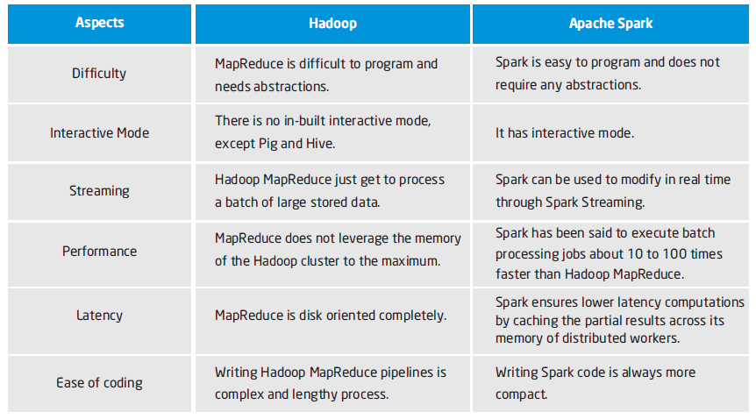
Apache Spark and MapReduce
Aspects
MapReduce
Spark

Slide 13
Using Apache Spark Interactive Shell
The Spark Shell provides interactive data exploration
(REPL) - Read-Eval(uate)-Print-Loop

Slide 14
Using Apache Spark Interactive Shell
There are two ways to manipulate data in Spark
Spark Shell:
Interactive–for learning or data exploration
Python or Scala
Spark Applications
For large scale data processing
Python, Scala, or Java

Slide 15
Using Apache Spark Interactive Shells
Spark comes with interactive shells that enable ad hoc data analysis
Spark’s shells will feel familiar if you have used other shells…
Such as those in R, Python, SQL, and Scala, or operating system shells like Bash
Unlike most other shells which let you manipulate data using the disk and memory on a single machine…
Spark’s shells allow you to interact with data distributed on disk or in memory across many machines…
And Spark takes care of automatically distributing this processing

Slide 16
Using Apache Spark Interactive Shells
Because Spark can load data into memory on worker nodes, many distributed computations, even ones that process terabytes of data across dozens of machines, can run in a few seconds
This makes the sort of iterative, ad hoc, and exploratory analysis commonly done in shells a good fit for Spark
Spark provides both Python and Scala shells that have been augmented to support connecting to a cluster
Spark shells provide a simple way to learn the Spark API as well as a powerful tool to analyze data interactively

Slide 17
Using Apache Spark Interactive Shells
The easiest way to demonstrate the power of Spark’s shells is to start using one of them for some simple data analysis
The first step is to open up one of Spark’s shells
To open the Python version of the Spark shell type
pyspark ← this is the one we shall use in our course
To open the Scala version of the Spark shell, type
spark-shell
The shell prompt should appear within a few seconds
When the shell starts you will see a lot of log messages
You may need to press Enter once to clear the log output and get to a shell prompt

Slide 18
Using Apache Spark Interactive Shells
pyspark defines a special variable ‘sc’ which is initialized to reference an instance of the SparkContext
A SparkContext provides the Spark client app an interface to the Spark execution engine
Once pyspark is started you can type lines of Saprk code in manually
Or you can execute a file of Spark statements by using the following command template:
exec(open("/path/to/file").read())
For example, exec(open("/home/hadoop/pydemo/test.py").read())
Unlike when you enter actions manually, you need to include print statements to see the results of such actions when using exec(…)

Slide 19
Using Apache Spark Self-Contained Applications
Suppose we wish to write a self-contained application using the Spark API
As an example, we’ll create a simple Spark application, SimpleApp.py:
"""SimpleApp.py"""
from pyspark import SparkContext
logFile = "YOUR_SPARK_HOME/README.md" # Should be some file on your system
sc = SparkContext("local", "Simple App")
logData = sc.textFile(logFile).cache()
numAs = logData.filter(lambda s: 'a' in s).count()
numBs = logData.filter(lambda s: 'b' in s).count()
print("Lines with a: %i, lines with b: %i" % (numAs, numBs))

Slide 20
Using Apache Spark Self-Contained Applications
This program just counts the number of lines containing ‘a’ and the number containing ‘b’ in a text file
We can pass Python functions to Spark, which are automatically serialized along with any variables that they reference
For applications that use custom classes or third-party libraries, we can also add code dependencies to spark-submit through its --py-files argument by packaging them into a .zip file
SimpleApp is simple enough that we do not need to specify code dependencies.
We can run this application using the bin/spark-submit script:
# Use spark-submit to run your application
$ spark-submit --master yarn -deploy-mode cluster SimpleApp.py
...
Lines with a: 46, Lines with b: 23

Slide 21
Spark On Hadoop
A Spark application contains several components…
All of which exist whether you are running Spark on a single machine or across a cluster of hundreds or thousands of nodes
Each component has a specific role in executing a Spark program
Some of these roles are passive during execution such as the client components…
And other roles are active in the execution of the program, including components executing computation functions
The components of a Spark application are the driver, the application master, the YARN cluster manager, and the executors that run on worker nodes
All of the Spark components, including the driver, master, and executor processes, run in Java virtual machines (JVMs)

Slide 22
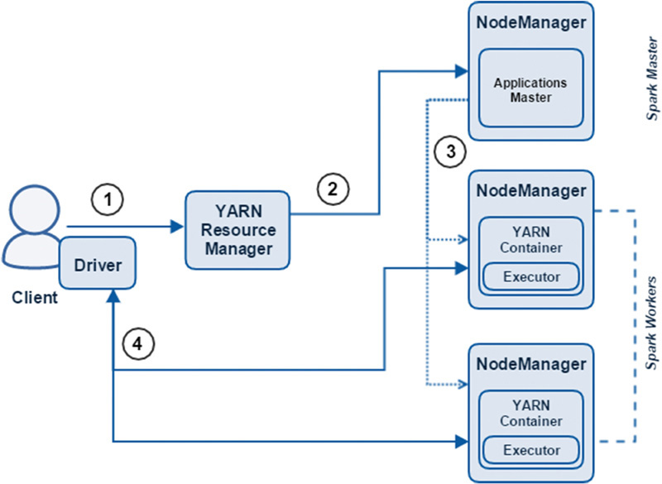
Spark On Hadoop Using an Interactive CLI

Slide 23
Spark On Hadoop Using an Interactive CLI
The client submits a Spark application to the cluster manager (the YARN ResourceManager). The driver process is created and runs on the client.
The ResourceManager assigns an ApplicationsMaster (the Spark master) for the application.
The ApplicationsMaster requests containers for executors from the ResourceManager. The containers are assigned and the executors are spawned.
The driver (located on the client) then communicates with the executors to marshal processing of tasks and stages of the Spark program. The driver returns progress, results, and status to the client.

Slide 24
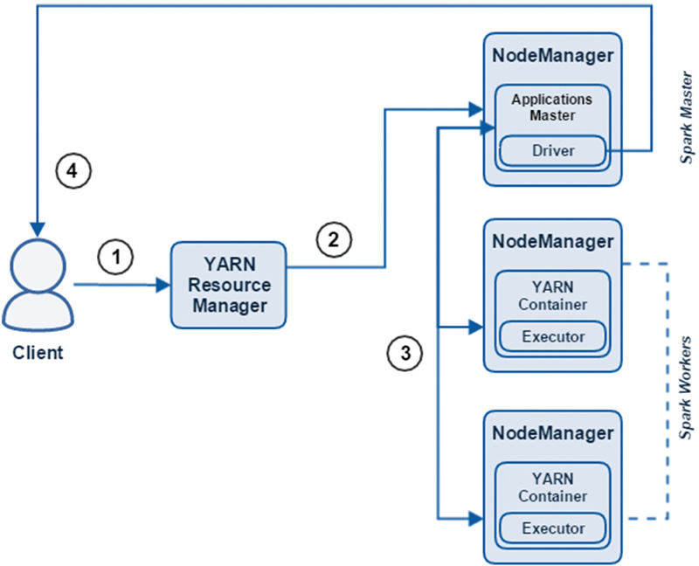
Spark On Hadoop Using a Self-Contained Program

Slide 25
Spark On Hadoop Using a Self-Contained Program
The client (a user process invoking spark-submit) submits a Spark application to the cluster manager (the YARN ResourceManager)
The ResourceManager assigns an ApplicationsMaster (the Spark master) for the application. The driver process is created on the same node
The ApplicationsMaster requests containers for executors from the ResourceManager. The containers are assigned and the executors are spawned. The driver then communicates with the executors to marshal processing of tasks and stages of the Spark program.
The driver returns progress, results, and status to the client

Slide 26
Relating Spark to Other Hadoop Systems
Data Representation
MapReduce→ key value pairs
Hive → table (with schema)
Pig → relation (without schema)
→ relation (with schema)
Spark → Resilient Distributed Datasets (RDDs)
like a Pig relation without schema.
like MapReduce can hold key value pairs
→ DataFrames
like a Hive table with schema

Slide 27
Relating Spark to Other Hadoop Systems
Data Operations
Hive → HQL (SQL-like language)
→ Hive CLI (or execute from .hql file)
Pig → Pig Latin (scripting language)
→ Pig CLI (or execute from .pig file)
Spark → Java, Scala, Python, R (programming languages)
→ Scala or Python CLI (or execute from program file)

Slide 28
Relating Spark to Other Hadoop Systems
Data Operations
MapReduce→ map, reduce, sort
Hive → SQL-like operators
Pig → Relational operators
takes a relation as input and produces
another relation as output.
→ Output operators
a DUMP or STORE statement is required
to generate output

Slide 29
Relating Spark to Other Hadoop Systems
Data Operations
Spark → SQL-like operators (on DataFrames)
→ Transformation operators (on RDDs)
like Pig relational operators.
takes an RDD as input and produces another
relation as output.
includes MR map-like, reduce-like and sort-like
operations.
→ Action operators (on RDDs)
like Pig output operators.
takes an RDD as input and produces some
result or stores into a file.

Slide 30
Resilient Distributed Datasets (RDD)
Spark’s core abstraction for working with data, is the resilient distributed dataset (RDD)
An RDD is simply a distributed collection of elements
In Spark all work is expressed as either creating new RDDs, transforming existing RDDs, or calling operations on RDDs to compute a result
Under the hood, Spark automatically distributes the data contained in RDDs across your cluster…
And parallelizes the operations you perform on them

Slide 31
Resilient Distributed Datasets (RDD)
An RDD in Spark is simply an immutable distributed collection of objects
Each RDD is split into multiple partitions, which may be computed on different nodes of the cluster
RDDs can contain any type of Python, Java, or Scala objects, including user-defined classes

Slide 32
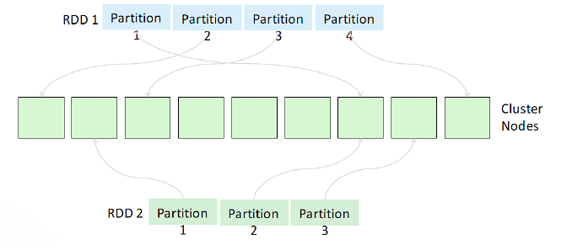
RDD and Partitions

Slide 33
Programming with RDDs
All work is expressed by either:
creating new RDDs
transforming existing RDDs
calling operations on RDDs to compute a result
Distributes the data contained in RDDs across the nodes (executors) in the cluster and parallelizes the operations.
Each RDD is split into multiple partitions, which can be computed on different nodes of the cluster

Slide 34
Resilient Distributed Datasets (RDD)
There are two ways to create RDDs:
parallelizing an existing collection in your driver program
referencing a dataset in an external storage system, such as a shared file system, HDFS, HBase, or any data source offering a Hadoop Input Format
Spark makes use of the concept of RDDs to achieve faster parallel processing speed than MapReduce

Slide 35
Resilient Distributed Datasets (RDD)
Parallelize a collection
Take an existing in-memory collection and pass it to SparkContext’s parallelize method
Not generally used outside of prototyping and testing since it requires entire dataset in memory on one machine
# Parallelize in Python
wordsRDD = sc.parallelize([“fish", “cats“, “dogs”])
Read from file
There are methods to read data from HDFS, S3, HBase etc.
# Read a local txt file in Python
linesRDD = sc.textFile("/path/to/README.md")

Slide 36
Resilient Distributed Datasets (RDD)
As one of the initial intended uses for Spark was to support machine learning, Spark’s RDDs provided a form of shared memory that could make efficient reuse of data for iterative operations
One of the main downsides of Hadoop’s implementation of MapReduce was its persistence of intermediate data to disk and the copying of this data between nodes at runtime
This distributed processing method of sharing data did provide resiliency and fault tolerance but it was at the cost of latency
As data volumes increased along with the necessity for real-time data processing and insights…
Spark’s (mainly) in-memory processing framework based on the RDD has grown in popularity

Slide 37
MapReduce File Based Processing
Map
Reduce
Map
Reduce
Local
File
System
Local
File
System
HDFS

Slide 38
Data Sharing is Slow in MapReduce
The only way to reuse data between two MapReduce jobs is to write it to an external storage system (Ex: HDFS)
So… Data sharing is slow in MapReduce due to overhead of replication, serialization, and disk IO
Most of the Hadoop applications spend more than 90% of the time doing HDFS read-write operations

Slide 39
Spark Adaptive (In Memory and File Based Processing)
RAM
Local
File
System
Local
File
System
Iteration
Stage1
Stage2
Stage3
Stage4
Local
File
System
Local
File
System
Local
File
System
HDFS

Slide 40
Data Sharing is Faster in Spark
Spark can store intermediate results in a distributed memory instead of stable storage (HDFS) and make the system faster
Note: If memory is insufficient to store all the intermediate results, then it will store those results on the disk

Slide 41
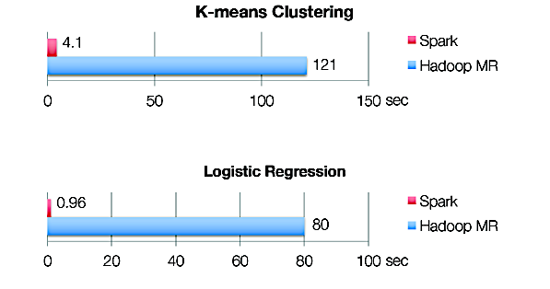
Iterative Algorithms: Spark vs MapReduce

Slide 42
Resilient Distributed Dataset (RDD)
The term Resilient Distributed Dataset is an accurate and succinct descriptor for the concept. Here’s how it breaks down:
Resilient
RDDs are resilient, meaning that if a node performing an operation in Spark is lost, the dataset can be reconstructed
This is because Spark knows the lineage of each RDD, which is the sequence of steps to create the RDD.
Distributed
RDDs are distributed, meaning the data in RDDs is divided into one or many partitions and distributed as in-memory collections of objects across worker nodes in the cluster
RDDs provide an effective form of shared memory to exchange data between processes (executors) on different nodes (workers)

Slide 43
Resilient Distributed Dataset (RDD)
Dataset
RDDs are datasets that consist of records
Records are uniquely identifiable data collections within a dataset
Records could be a collection of fields similar to a row in a table in a relational database, a line of text in a file, or multiple other formats.
RDDs are partitioned such that each partition contains a unique set of records and can be operated on independently

Slide 44
Resilient Distributed Datasets (RDD)
Another key property of RDDs is their immutability
This means that after they are instantiated and populated with data, they cannot be updated
Rather, new RDDs are created by performing one or more transformations such as map() or filter() on existing RDDs

Slide 45
Data Locality with RDDs
By default, Spark tries to read data into an RDD from the nodes that are close to it.
As Spark usually accesses distributed partitioned data to optimize transformation operations…
It creates partitions to hold the underlying blocks from HDFS

Slide 46
Resilient Distributed Dataset (RDD)
Because Spark can load data into memory on the worker nodes, many distributed computations, even ones that process terabytes of data across dozens of machines, can run in a few seconds
This makes the sort of iterative, ad hoc, and exploratory analysis commonly done in shells a good fit for Spark
Spark provides both Python and Scala shells that have been augmented to support connecting to a cluster

Slide 47
Resilient Distributed Dataset (RDD) Transformation and Actions
Once created, RDDs offer two types of operations transformations and actions
Transformations construct a new RDD from a previous one.
For example, one common transformation is filtering data that matches a predicate
In our example, we use this to create a new RDD holding just the strings that contain the word Python
pythonLines = textLines.filter(lambda line: "Python" in line)
Source RDD holding lines of text. Some lines contain the word Python
New RDD holding lines of text each of which contain the word Python

Slide 48
Resilient Distributed Dataset (RDD) Transformation and Actions
Actions, on the other hand, compute a result based on an RDD, and either return it to the driver program or save it to an external storage system (e.g., HDFS)
One example of an action is first(), which returns the first element in an RDD as demonstrated
someString = pythonLines.first()
Returns the first record of the RDD as a string. An aciton does not create an RDD.

Slide 49
RDD Fault Tolerance
RDDs track the transformations used to build them (their lineage) to recompute lost data
E.g:
messages = textFile(...).filter(lambda s: s.contains(“ERROR”))
.map(lambda s: s.split(‘\t’)[2])
HadoopRDD
path = hdfs://…
FilteredRDD
func = contains(...)
MappedRDD
func = split(…)
Notes:
Show recomputing

Slide 50
Resilient Distributed Dataset (RDD) Transformation and Actions
Transformations and actions are different because of the way Spark computes RDDs
Although you can define new RDDs any time, Spark computes them only in a lazy fashion—that is, the first time they are used in an action
Once Spark sees a whole chain of transformations, it can compute just the data needed for its result

Slide 51
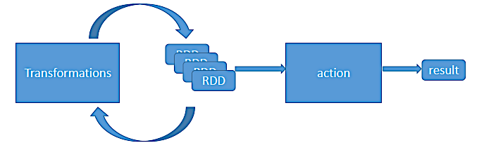
RDD: Actions and Transformations
Two types of operations on RDDs:
transformations and actions
transformations –lazy operations that return another RDD
actions –operations that trigger computation and return value

Slide 52
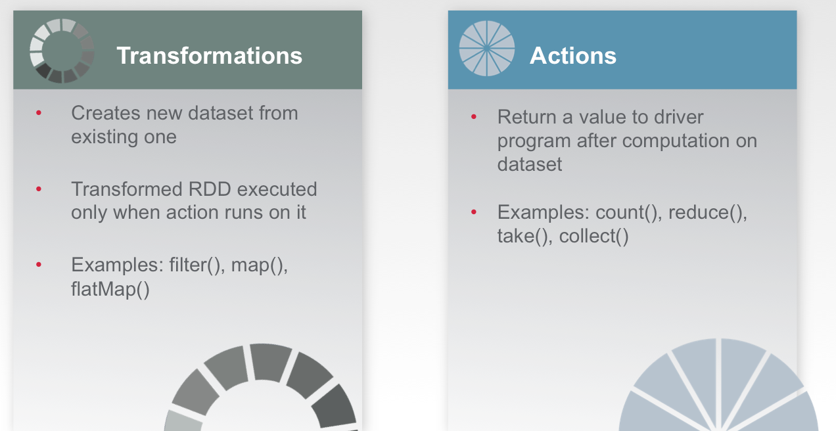
Transformations and Actions Summary

Slide 53
Resilient Distributed Dataset (RDD) Caching
Finally, Spark’s RDDs are by default recomputed each time you run an action on them
If you would like to reuse an RDD in multiple actions, you can ask Spark to cache (persist) it in memory
We can ask Spark to persist our data in a number of different places
After computing it the first time, Spark will store the RDD contents in memory (partitioned across the machines in your cluster), and reuse them in future actions
Persisting RDDs on disk instead of memory is also possible
The behavior of not persisting by default may again seem unusual, but it makes a lot of sense for big datasets
If you will not reuse the RDD, there’s no reason to waste storage space when Spark could instead stream through the data once and just compute the result

Slide 54
Resilient Distributed Dataset (RDD) Caching
Spark can persist (or cache) an RDD in memory across operations
Each node stores in memory any partitions of an RDD that it computes
It then reuses them in other actions on that RDD
Often making future actions more than 10x faster
The cache is fault-tolerant
If any partition of an RDD is lost, it will automatically be recomputed using the transformations that originally created it

Slide 55
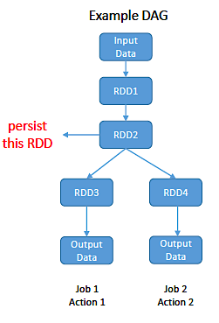
Resilient Distributed Dataset (RDD) Caching
When an RDD is marked as persist(),the first time it is computed in a action it will be kept in the memory of the nodes
You can persist with different storage level options
MEMORY_ONLY or MEMORY_AND_DISK, etc.
persist() or cache() is key for iterative algorithms
cache() is same as persist() with the MEMORY_ONLY storage option

Slide 56
Resilient Distributed Dataset (RDD) Caching
Caching is very useful when data is accessed repeatedly, such as when querying a small “hot” dataset, or when running an iterative algorithm like PageRank
As a simple example, let’s mark our linesWithSpark dataset to be cached:
>>> linesWithSpark.cache()
>>> linesWithSpark.count()
19
>>> linesWithSpark.count()
19
These same functions can be used on very large data sets, even when they are striped across tens or hundreds of nodes

Slide 57
Resilient Distributed Dataset (RDD) Processing
To summarize, every Spark program and shell session will work as follows:
Create some input RDDs from external data or parallelize a collection in your driver program
Lazily transform them to define new RDDs using transformations like filter() or map()
Optional: Ask Spark to cache() any intermediate RDDs that will need to be reused
Launch actions such as count() and collect() to kick off a parallel computation, which is optimized and executed by Spark

Slide 58
Job Scheduling

Slide 59
Apache Spark Lambda Functions
In Python, an anonymous function is a function that is defined without a name
Normal Python functions are defined using the “def” keyword
Anonymous functions are defined using the lambda keyword
Hence, anonymous functions are also called lambda functions
A lambda function has the following syntax…
lambda arguments: expression
Lambda functions can have any number of arguments but only one expression
The expression is evaluated and returned
Lambda functions can be used wherever function objects are required

Slide 60
Apache Spark Lambda Functions
So for Spark it is correct to code either of the following
Using a named function
def g (x):
x < 25
# include in otherRdd only those records of someRdd with value less
# than 25
otherRdd = someRdd.filter(g)
Using a lambda function
otherRdd = someRdd.filter(lambda x: x < 25)
The lambda approach is often more readable in Scala and Python, but less so when using Java

Slide 61
Example: Word Count
lines = sc.textFile(“hamlet.txt”)
words = lines.flatMap(lambda line: line.split(“ “))
wordPairs = words.map(lambda word: (word, 1))
wordCounts = wordPairs.reduceByKey(lambda x, y: x + y)
lines words wordPairs wordCounts
flatMap map reduceByKey

Slide 62
Apache Spark WordCount Example
Load a file from HDFS into an RDD. Each record is a line from the original file
Here ‘sc’ represents the system context—a connection to the Hadoop cluster
lines = sc.textFile(“/user/jrosen/document.txt")
Split apart the words in each record of the lines RDD
Make each word its own record in a new words RDD using the flatMap() transformation
Note from one record “line” flatMap produces a list of records each one a word
words = lines.flatMap(lambda line: line.split(" "))
For each word in the words RDD create a key value pair of the form (word, 1) using the map transformation
wordPairs = words.map(lambda word: (word, 1))

Slide 63
Apache Spark WordCount Example
Now group each of the values in the wordPairs RDD by key of the form (key, (1, 1, …)) using the reduceByKey() transformation
And add all the 1’s for a key together to get the count of times a word appears
wordCounts = wordPairs.reduceByKey(lambda a, b: a + b)
Now store the word count RDD to HDFS using the saveAsTextFile() action
wordCount.saveAsTextFile(“/user/jrosen/wordCounts.txt")

Slide 64
Example: Mine error logs
Load error messages from a log into memory, then interactively search for various patterns:
# load file from HDFS into an RDD
lines = spark.textFile(“hdfs://...”)
# create a new RDD holding log records starting with “ERROR” <- transformation
errors = lines.filter(lambda s: s.startswith(“ERROR”))
# create a new RDD holding only the third field of each log record <- transformation
messages = errors.map(lambda s: s.split(“\t”)[2])
# cache the RDD in RAM (if possible) otherwise on disk
messages.cache() <- transformation
# create a new RDD holding only records containing the substring “foo” <- transformation
fooErrors = messages.filter(lambda s: “foo” in s)
# output the count of foo errors <- action, now transformations are executed
print (fooErrors.count())

Slide 65
Tips
Recall that transformations execute in a lazy fashion…
Only upon execution of an action
So if you provide a wrong argument to a transformation that can only be checked at run time…
This will only become apparent when you execute an action
For example, let’s say you want to load a text file named “/user/test123.txt”
But you enter the following incorrect file name in your load command
someRdd = sc.textFile(“/user/test123”)
Notice that you left off the “.txt” suffix
This will be accepted by the spark shell without complaint at entry time
But if you try to employ the following you will get an error, not from the action, but form the prior transformation
someRdd.take(5)

Slide 66
Tips
So as you are starting to explore spark just execute a simple action after you enter each transformation
A good choice is the “take(n)” transformation where n is some usually some small number, say 5
If that works you are assured your transformation arguments are basically correct
It also provides some idea of what the form and content of your transformation might be

Slide 67
Tips
Sometimes after executing a spark statement interactively the prompt does not display again until you hit “enter” one or two times

Slide 68
API Overview
Spark’s capabilities can all be accessed and controlled using a rich API
This supports Spark’s four principal development environments
Scala, Java, Python, R
Extensive documentation is provided regarding the API’s instantiation in each of these languages
The Spark Programming Guide provides further detail, with comprehensive code snippets in Scala, Java and Python
The Spark API was optimized for manipulating data, with a design that reduced some common data science tasks from 100’s or 1000’s of lines of code to only a few

Slide 69
Programming with RDDs
All work is expressed by either:
creating new RDDs
transforming existing RDDs
calling operations on RDDs to compute a result
Distributes the data contained in RDDs across the nodes (executors) in the cluster and parallelizes the operations.
Each RDD is split into multiple partitions, which can be computed on different nodes of the cluster

Slide 70
Programming Spark in Python (pySpark)
We will use Python’s interface to Spark called pySpark
A driver program accesses the Spark environment through a SparkContext object
They key concept in Spark are datasets called RDDs (Resilient Distributed Dateset )
Basic idea: We load our data into RDDs and perform some operations

Slide 71
Programming environment - Spark concepts
Driver programs access Spark through a SparkContext object which represents a connection to the computing cluster
In a shell the SparkContext is created for you and available as the variable sc
You can use it to build Resilient Distributed Data (RDD) objects
Driver programs manage a number of worker nodes called executors

Slide 72
textfile(filepath)
Text file RDDs can be created using SparkContext’s textFile method
This method takes an URI for the file (either a local path on the machine, or a hdfs://, s3://, etc URI) and reads it as a collection of lines
By default, Spark creates one partition for each HDFS block of the file
someRDD = sc.textFile("data.txt")
someRDD = sc.textFile(“hdfs:///user/hadoop/data.txt")
someRDD = sc.textFile(“s3://mybucket/data.txt")

Slide 73
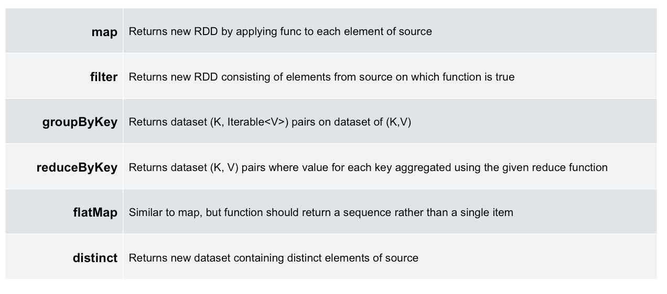
Example Transformations

Slide 74
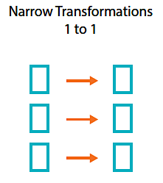
Transformations
Narrow Transformations
Narrow transformations are the result of map, filter and similar, that is, using the data from a single partition only.
An output RDD has partitions with records that originate from a single partition in the parent RDD
Only a limited subset of partitions used to calculate the result.
Spark groups narrow transformations as a stage which is called pipelining

Slide 75
Transformations
Wide Transformations
Wide transformations are the result of groupByKey and reduceByKey.
The data required to compute the records in a single partition may reside in many partitions of the parent RDD
Note, wide transformations are also called shuffle transformations as they may or may not depend on a shuffle
All of the tuples with the same key must end up in the same partition, processed by the same task

Slide 76
Transformations filter(func)
Description
Return a new dataset formed by selecting those elements of the source on which func returns true
Filter operator is somewhat equivalent to the WHERE clause in SQL
The function expression must always evaluate to (and return) a boolean type

Slide 77
Transformations filter(func)
Example
Input RDD (inRDD)
u'Joe,44,33,41,1'
u'Mel,13,33,30,50‘
u'Jill,32,25,4,6'
u'Jill,3,37,15,4'
u'Jill,14,41,7,25’
Operation
inRdd = sc.textFile(“user/test123.txt”)
filterRdd = inRdd.filter(lambda line: “Jill” in line)
Output RDD (filterRDD)
u'Jill,32,25,4,6'
u'Jill,3,37,15,4'
u'Jill,14,41,7,25'

Slide 78
Transformations map(func)
Return a new distributed dataset formed by passing each element of the source through a function func
If func returns a collection of results then all those results are still grouped into one record

Slide 79
Transformations map(func)
Output RDD
u'JOE', u'44', u'33', u'41', u'1‘
u‘MEL', u'13', u'33', u'30', u'50‘
u‘MEL', u'12', u'40', u'30', u'42‘
u'SAM', u'15', u'28', u'28', u'39‘
u'MEL', u'9', u'23', u'17', u'2‘
…
Example
Input RDD
u'Joe,44,33,41,1'
u'Mel,13,33,30,50'
u'Mel,12,40,30,42'
u'Sam,15,28,28,39'
u'Mel,9,23,17,2‘
…
Operation
inRdd = sc.textFile(“user/test123.txt”)
upperRdd = inRdd.map(lambda line: line.upper())
Note, the upper function accepts a string as input and returns a single string as output
Note we still take one record as input to the map function and produce one record as output

Slide 80
Transformations map(func)
Output RDD
u'Joe', u'44', u'33', u'41', u'1‘ ⬅ each record is a list of items
u'Mel', u'13', u'33', u'30', u'50‘
u'Mel', u'12', u'40', u'30', u'42‘
…
Example
Input RDD
u'Joe,44,33,41,1'
u'Mel,13,33,30,50'
u'Mel,12,40,30,42'
…
Operation
inRdd = sc.textFile(“user/test123.txt”)
splitRdd = inRdd.map(lambda line: line.split(“,”))
Note, the split function returns a list (collection) of words
We still take one record as input to the map function and produce one record as output
Here each output record, rather than being a single string, is split into a collection of strings after using “,” as the delimiter
This collection of strings is then taken to be a single output record and not a record per collection member

Slide 81
Transformations flatMap(func)
Similar to map, but each input record can be mapped to 0 or more output records…
So if func should return a collection rather than a single item each collection member becomes a new record
Here one record at a time is passed to func which then outputs zero or more results as a collection
Each member of the collection becomes a new record in the resulting RDD

Slide 82
Transformations flatMap(func)
Output RDD
u'Joe'
u'44‘
u'33‘
u'41‘
u'1‘
u'Mel‘
u'13‘
u'33‘
u’30’
u’50’
…
Example
Input RDD
u'Joe,44,33,41,1'
u'Mel,13,33,30,50'
u'Mel,12,40,30,42'
u'Sam,15,28,28,39'
u'Mel,9,23,17,2‘
…
Operation
inRdd = sc.textFile(“user/test123.txt”)
flatRdd = inRdd.flatMap(lambda line: line.split(“,”))
The function “split” returns a list (collection) of strings using “,” as the delimiter
The collection is “flattened” such that each collection member becomes a new record in the output RDD

Slide 83
Transformations Working with Key-Value Pairs
Most Spark operations work on RDDs containing any type of objects
But there a few special operations only available on RDDs holding key-value pairs
These RDDs are called “pair RDDs”
Pair RDDs are a useful as they allow operations that allow you to act on each key in parallel or group data across the network
The most common operations are distributed “shuffle” operations…
These include grouping or aggregating the elements by a key
In Python, these operations work on RDDs containing built-in Python tuples such as (1, 2)
Simply create such tuples and then call your desired operation

Slide 84
Creating a Pair RDD
Pair RDDs can be created by running a map() function that returns key-value pairs
The procedure to build the key-value RDDs differs by language
In Python language, for the functions on keyed data to work we need to return an RDD composed of tuples
Creating a pair RDD using the first word as the key in Python programming language:
pairs = lines.map(lambda x: (x.split(" ")[0], x))

Slide 85
Creating a Pair RDD
Output RDD
(u'Joe', 1)
(u'44', 1)
(u'33', 1)
(u'41', 1)
(u'1', 1)
(u‘Mel', 1)
(u‘13', 1)
(u'33', 1)
…
Example
Input RDD
u'Joe'
u'44‘
u'33‘
u'41‘
u'1‘
u'Mel‘
u'13‘
u'33‘
…
Operation
wordsRdd = inRdd.map(lambda word: (word, 1))
For each word (record) in the input RDD form a pair (word, 1)

Slide 86
Transformations on Pair RDDs
Aggregation
Grouping
Joining
Sorting

Slide 87
Aggregations
When datasets are described in terms of key or value pairs…
It is common need is aggregate statistics across all elements with the same key
Spark has a set of operations that process values associated with the same key
These operations return RDDs and are transformations rather than actions
reduceByKey()
foldByKey() [not discussed further]
combineByKey() [not discussed further]

Slide 88
Transformations reduceByKey(func, [numTasks])
We start with a dataset of (K, V) pairs
The values for each key are aggregated using the given reduce function func, which must be of type (V,V) => V
The number of reduce tasks is configurable through an optional second argument

Slide 89
Transformations reduceByKey(func, [numTasks])
Let’s begin with a simple function to be used as an argument to reduceByKey()
Now let’s assume we have a pair RDD that looks as follows…
(“jill”, 1)
(“jill”, 1)
(“Jack”, 1)
(“Jack”, 1)
(“Jack”, 1)
What we want to do is create an output RDD with all the 1’s associated with each name summed up follows:
(“Jill”, 2)
(“Jack”, 3)

Slide 90
Transformations reduceByKey(func, [numTasks])
Conceptually this can be done as a two step process
First group all the values associated with a single key into a collection
(“jill”, [1, 1])
(“Jack”, [1, 1, 1])
Note this step is conceptually the same as groupByKey()
Next sum up the 1’s in the list associated with each key together
The way this is represented in a spark aggregation function is as follows
lambda (x, x) : x + x
But how is this function applied by spark to arrive at the following?
(“Jill”, 2)
(“Jack”, 3)

Slide 91
Transformations reduceByKey(func, [numTasks])
It works as follows for key “Jack” - (“Jack”, [1, 1, 1])
Keep applying the lambda function until one value is produced
x + y
[
1
1
1
]
(1 + 1) + 1
lambda (x, y) : x + y
x + y
1 + 1
2
2 + 1
2 + 1
3
3

Slide 92
Transformations reduceByKey(func, [numTasks])
Example
Output RDD
(u'Joe', 2)
(u'44', 1)
(u‘12', 2)
(u'41', 1)
(u'1', 1)]
(u'33', 1)
(u‘21', 1)
(u'11', 1)
…
Example
Input RDD
(u'Joe', 1)
(u'44', 1)
(u‘12', 1)
(u'41', 1)
(u'1', 1)
(u'Joe', 1)
(u‘12', 1)
(u'33', 1)
(u‘21', 1)
(u'11', 1)
…
Operation
wordsRdd = inRdd.reduce(lambda (x, y) : x + y)
Sum the 1’s associated with each key
x + y

Slide 93
Grouping Data
With key value data a common use case is grouping our data sets with respect to predefined key value
For example, viewing all of a customer’s orders together as one unit
If our customer data is organized as key value pairs where each key is as name and each value is an order
We can use groupByKey() to our order data by customer name into an RDD
On an RDD consisting of keys of type K and values of type V…
We get back an RDD operation of type [K, Iterable[V]]

Slide 94
Transformations groupByKey([numTasks])
When called on a dataset of (K, V) pairs, returns a dataset of (K, Iterable<V>) pairs

Slide 95
Transformations groupByKey([numTasks])
Output RDD
(u'Joe', [1, 1])
(u'44’, [1])
(u‘12', [1, 1])
(u'41’, [1])
(u'1’, [1])
(u'33’, [1])
(u‘21’, [1])
(u'11’, [1])
…
Example
Input RDD
(u'Joe', 1)
(u'44', 1)
(u‘12', 1)
(u'41', 1)
(u'1', 1)]
(u'Joe', 1)
(u‘12', 1)
(u'33', 1)
(u‘21', 1)
(u'11', 1)
…
Operation
wordsRdd = inRdd.groupByKey()
Collects the 1’s associated with each key

Slide 96
ReduceByKey() Versus GroupByKey()
While both of these functions will produce the correct answer, reduceByKey works much better on a large dataset
That's because Spark knows it can combine output with a common key on each partition before shuffling the data.
Look at the diagram below to understand what happens with reduceByKey. Notice how pairs on the same machine with the same key are combined (by using the lamdba function passed into reduceByKey) before the data is shuffled. Then the lamdba function is called again to reduce all the values from each partition to produce one final result.

Slide 97
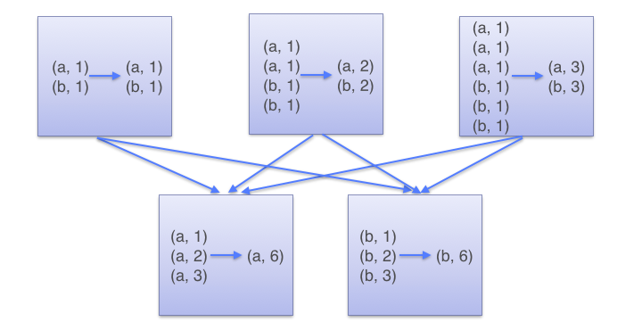
ReduceByKey() Versus GroupByKey()
Look at the diagram below to see what happens with reduceByKey.
Pairs on the same machine with the same key are combined (by using lamdba function passed into reduceByKey) before the data is shuffled
Then the lamdba function is called again to reduce all the values from each partition to produce one final result.

Slide 98
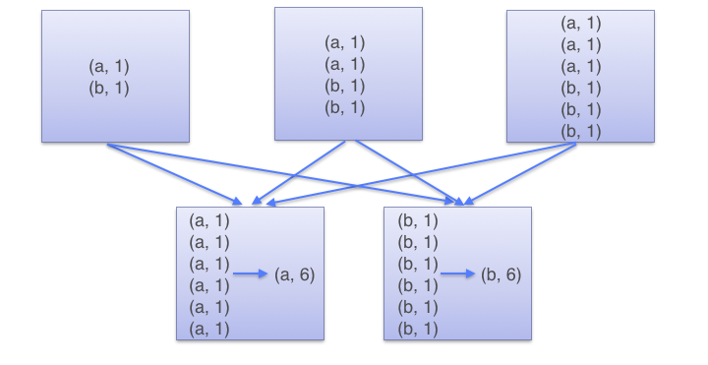
ReduceByKey() Versus GroupByKey()
On the other hand, when calling groupByKey - all the key-value pairs are shuffled around
This is a lot of unnecessary data to being transferred over the network.

Slide 99
Joining
The most useful and effective operations we get with keyed data values comes from using it with other keyed data
Joining datasets together is one of the most common type of operations you can find out on a pair RDD
Inner Join() : Only keys that are present in both pair RDDs have values that in the output RDD
leftOuterJoin() : The resulting pair RDD has entries for each key in the source RDD
rightOuterJoin() : is almost identical functioning to leftOuterJoin () except the key must be present in the other RDD

Slide 100
Transformations join(otherDataset, [numTasks])
When called on datasets of type (K, V) and (K, W), returns a dataset of (K, (V, W)) pairs, with all pairs of elements for each key

Slide 101
Transformations join(otherDataset, [numTasks])
Input RDD2 (in2Rdd)
(u'Joe', 5)
(u'44', 5)
(u‘12', 5)
(u'41', 5)
(u'1', 1)]
(u'33', 5)
(u‘21', 5)
(u'11', 5)
…
Output RDD
(u'Joe', (1, 5))
(u'44', (1, 5))
(u‘12', (1, 5))
(u'41', (1, 5))
(u'1', (1, 5))
(u'33', (1, 5))
(u‘21', (1, 5))
(u'11', (1, 5))
…
Example
Input RDD1 (in1Rdd)
(u'Joe', 1)
(u'44', 1)
(u‘12', 1)
(u'41', 1)
(u'1', 1)]
(u'33', 1)
(u‘21', 1)
(u'11', 1)
…
Operation
joinRdd = in1Rdd.join(in2Rdd)
Note that the join of values creates a list of the value parts of each pair RDD

Slide 102
Sorting Data
We can sort an RDD with key or value pairs provided that there is an ordering defined on the key set
Once we have sorted our data elements, any following call on the sorted data to collect() or save() will result in ordered dataset

Slide 103
Transformations sortByKey([ascending], [numTasks])
When called on a dataset of (K, V) pairs where K implements Ordered…
Returns a dataset of (K, V) pairs sorted by keys in ascending or descending order as specified in the boolean ascending argument.

Slide 104
Transformations sortByKey(asending, [numTasks])
Output RDD
(u'Joe', 1)
(u'Joe', 1)
(u'44', 1)
(u'41', 1)
(u'33', 1)
(u‘21', 1)
(u‘12', 1)
(u‘12', 1)
(u'11', 1)
(u'1', 1)]
…
Example
Input RDD (inRdd)
(u'Joe', 1)
(u'44', 1)
(u‘12', 1)
(u'41', 1)
(u'1', 1)]
(u'Joe', 1)
(u‘12', 1)
(u'33', 1)
(u‘21', 1)
(u'11', 1)]
…
Operation
sortRdd = inRdd.sortByKey(False)
Sort keys in descending order

Slide 105
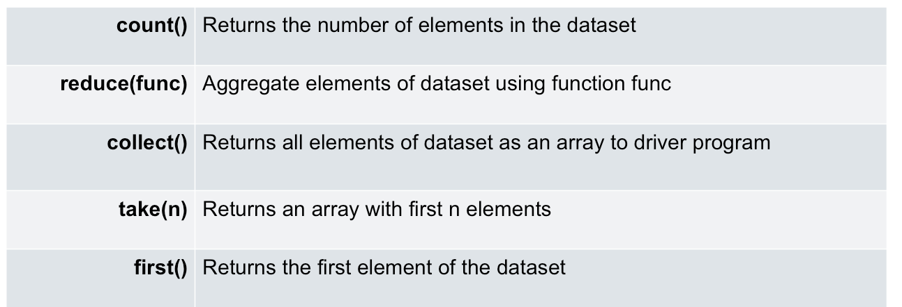
Example Actions

Slide 106
Actions count()
Return the number of elements in the dataset

Slide 107
Actions count()
Example
Input RDD (inRdd)
(u'Joe', 1)
(u'Joe', 1)
(u'44', 1)
(u'41', 1)
(u'33', 1)
(u‘21', 1)
(u‘12', 1)
(u‘12', 1)
(u'11', 1)
(u'1', 1)]
…
Operation
inRdd.count()
Output
5500 (count of the number of records in the RDD)

Slide 108
Actions collect()
Return all the elements of the dataset as an array at the driver program
This is usually useful after a filter or other operation that returns a sufficiently small subset of the data

Slide 109
Actions collect()
Example
Input RDD (inRdd)
u'Joe,44,33,41,1'
u'Mel,13,33,30,50'
u'Mel,12,40,30,42'
u'Sam,15,28,28,39'
u'Mel,9,23,17,2‘
…
Operation
someArray = inRdd.collect()
All data of inRdd is provided to the client program
This could exhaust memory if the result is too large
Note the result is not an RDD but an array
Output Array
[ u'Joe,44,33,41,1'
u'Mel,13,33,30,50'
u'Mel,12,40,30,42'
u'Sam,15,28,28,39'
u'Mel,9,23,17,2‘
… ]

Slide 110
Actions reduce()
Aggregate the elements of the dataset using a function func which takes two arguments and returns one
The function should be commutative and associative so that it can be computed correctly in parallel

Slide 111
Actions reduce()
Temp (recLenRdd)
14
14
14
14
12
….
Output (totalLen)
print totalLen
24375
Example
Input RDD (inRdd)
u'Joe,44,33,41,1'
u'Mel,13,33,30,50'
u'Mel,12,40,30,42'
u'Sam,15,28,28,39'
u'Mel,9,23,17,2‘
…
Operation
recLenRdd = inRdd.map(lambda s: len(s))
totalLen = recLenRdd.reduce(lambda a, b: a + b)
The first line defines recLenRdd as the result of a map transformation
We then run reduce, which is an action
Spark breaks the computation into tasks to run on separate machines…
And each machine runs its part of the map and a local reduction, returning only its answer to the driver program

Slide 112
Actions take(n)
Return an array with the first n elements of the dataset

Slide 113
Actions takeSample(withReplacement, num, [seed])
Return an array with a random sample of num elements of the dataset, with or without replacement (boolean)
Optionally pre-specify a random number generator seed
data.takeSample(False, 100, None)
Get a random sample of an RDD (named data) to get 100 of its values

Slide 114
Actions sample(withReplacement, fraction, [seed])
Return an array with a random sample of a percent of the elements of the dataset, with or without replacement (boolean)
Optionally pre-specify a random number generator seed
May be faster than takeSample()
data.sample(False, 0.2, None)
Get a random sample of an RDD (named data) to get 20% of its values

Slide 115
Actions first()
Return the first element of the dataset (similar to take(1))

Slide 116
Actions foreach(func)
Run a function func on each element of the dataset
Unlike other actions, foreach do not return any value
It simply operates on all the elements in the RDD
foreach() can be used in situations, where we do not want to return any result, but want to initiate a computation

Slide 117
Actions foreach(func)
Output
Joe,44,33,41,1
Mel,13,33,30,50
Mel,12,40,30,42
Sam,15,28,28,39
Mel,9,23,17,2
…
Example
Input RDD (inRdd)
u'Joe,44,33,41,1'
u'Mel,13,33,30,50'
u'Mel,12,40,30,42'
u'Sam,15,28,28,39'
u'Mel,9,23,17,2‘
…
Operation
def p(x)
print x
inRdd.foreach(p);

Slide 118
Actions saveAsTextFile(path)
Write elements of the dataset as a text file (or set of text files) in a given directory in the local filesystem, HDFS or any other Hadoop-supported file system
Spark will call toString() on each element to convert it to a line of text in the file

Slide 119
Shared Variables
Normally, when a function passed to a Spark operation (such as map or reduce) is executed on a remote cluster node, it works on separate copies of all variables used in the function
These variables are copied to each machine, and no updates to the variables on the remote machine are propagated back to the driver program
Supporting general, read-write shared variables across tasks would be inefficient
However, Spark does provide two limited types of shared variables for two common usage patterns…
Broadcast variables and accumulators (not discussed)

Slide 120
Broadcast Variables
Broadcast variables allow the programmer to keep a read-only variable cached on each machine rather than shipping a copy of it with tasks
They can be used, for example, to give every node a copy of a large input dataset once in an efficient manner, rather than each time a spark function (closure) is executed
The best examples of use of broadcast variables are for distributing large reference data or lookup tables
Spark attempts to distribute broadcast variables using efficient broadcast algorithms to reduce communication cost

Slide 121
Broadcast Variables
Broadcast variables are created from a variable v by calling SparkContext.broadcast(v)
The broadcast variable is a wrapper around v, and its value can be accessed by calling the value method
The Python code below shows this
data = [1, 2, 3]
broadcastVar = sc.broadcast(data)
# The array ‘data’ is now available on every cluster node to be
# accessed as follows
someRdd = otherRdd.filter (lambda x : x < broadcastVar.value[0])

